Slide 1

Power BI Analysis
Airplane Crash Analysis
By Ahmed Mansour

Slide 2



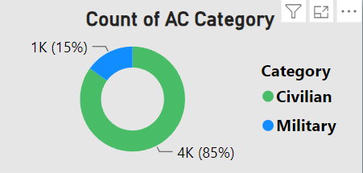

15%
85%

Slide 3


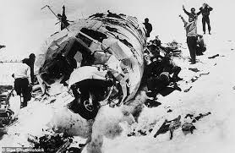

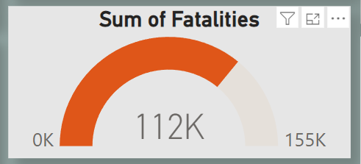

Number of Survived doesn’t exceeded 30%
of all Abroad.
Number of Deaths was larger
comparing with Survived.
3

Slide 4

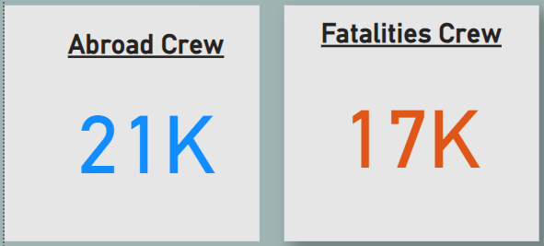



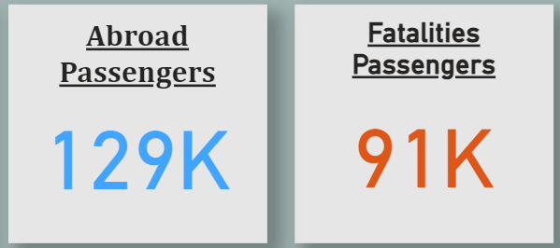

4

Slide 5
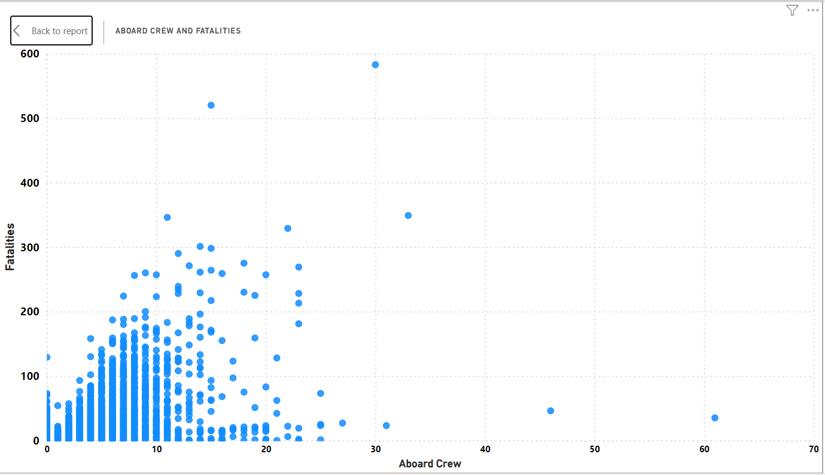
Higher Number of Crew
Lower Deaths

Slide 6

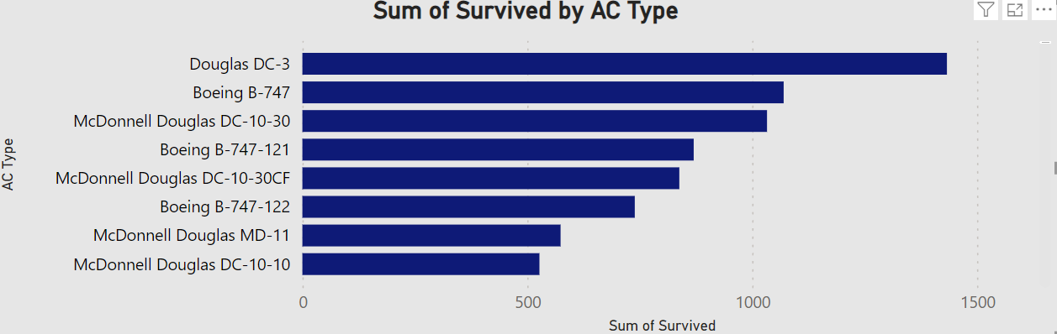
Number of Survived by each AC
Douglas Company has high Frequency in our Dataset.
In Survived & Fatalities
3

Slide 7

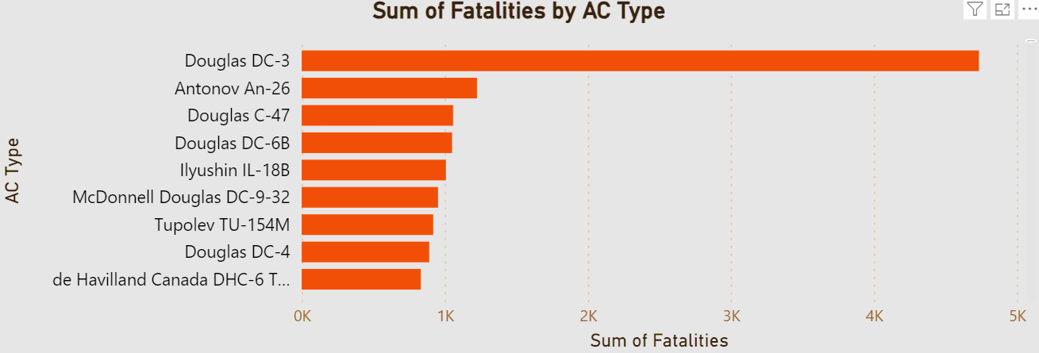
Number of Deaths by each AC
5

Slide 8

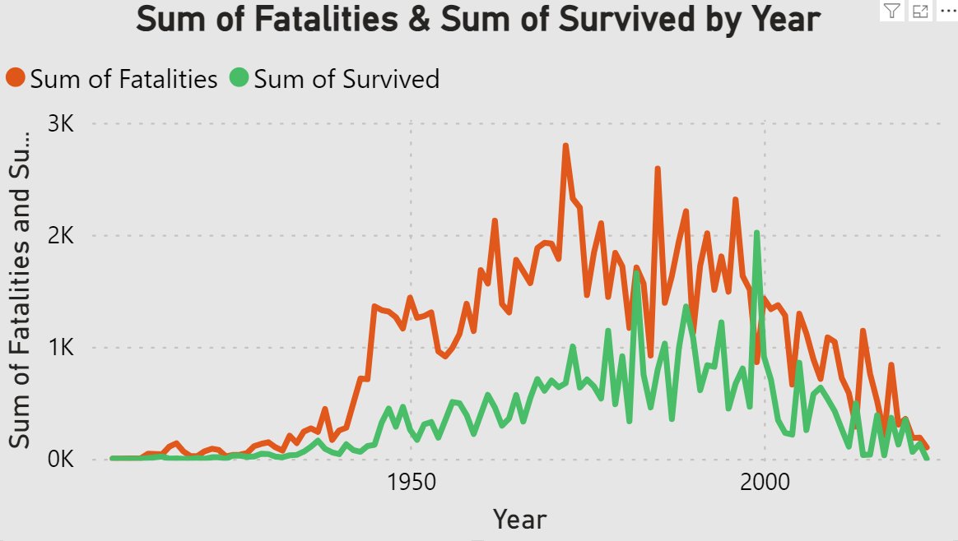
Fatalities & Survived by Year
Year 1972 has recorded largest number of Deaths.
Range from 1945 to 2014 Recorded larger than 1K deaths on each year.

Slide 9
Average of Deaths by Months
July has Large Average on Number of Deaths
10

Slide 10
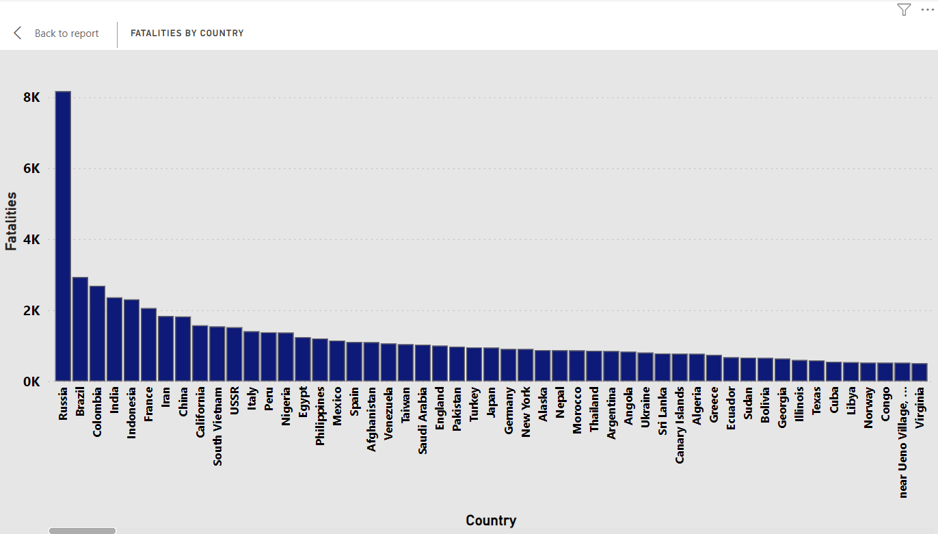
Number of Deaths By Country

Slide 11
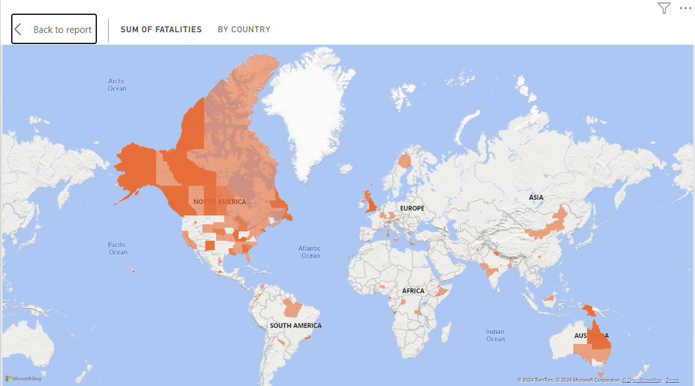
3

Slide 12

THANK YOU

